Slide 1
Boom or Bust: Examining the Relationship between High School Recruiting Rankings and the NFL Draft
By Nick Tice
University of South Carolina
Thesis Director: Dr. Joshua Tebbs
Second Reader: Dr. Khalid Ballouli

Slide 2

Personal Background
Always interested in how the drafting process across all sports works
NFL and NBA have turned their drafts into big events on their calendar
Fans get excited about mock drafts
Watch teams convince themselves how great their picks are every year
Notes:
Talk about Samford

Slide 3
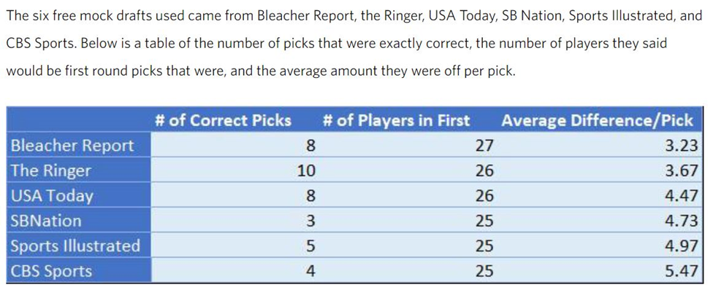
Educational Background
Utilize my Statistics and Sport and Entertainment Management degrees to explore this issue
Summer internship with Samford Center for Sports Analytics

Slide 4
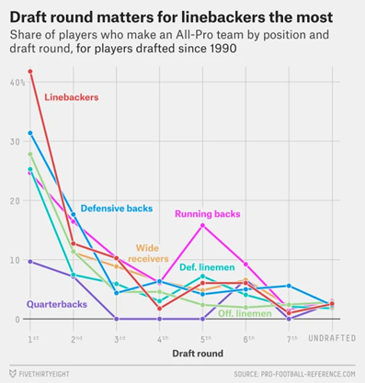
Draft Inefficiencies
256 players chosen in every NFL Draft
In every draft there are many picks that never amount to anything in the league
Linebacker is the “safest” position and only hits 42% of the time in the first round
Front offices becoming more analytics driven → Sloan
Contention with the traditional vs. analytics mentality

Slide 5
Goal
Look at recruiting profiles and demographic data for high school football recruits
Identify which traits have the most significant effect on being drafted
Determine the best recruiting service and prospects from the analyzed time period

Slide 6
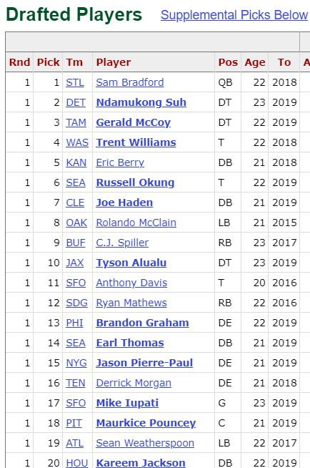
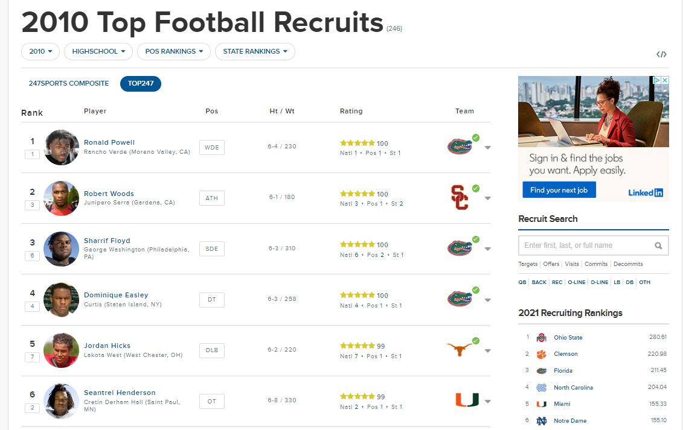
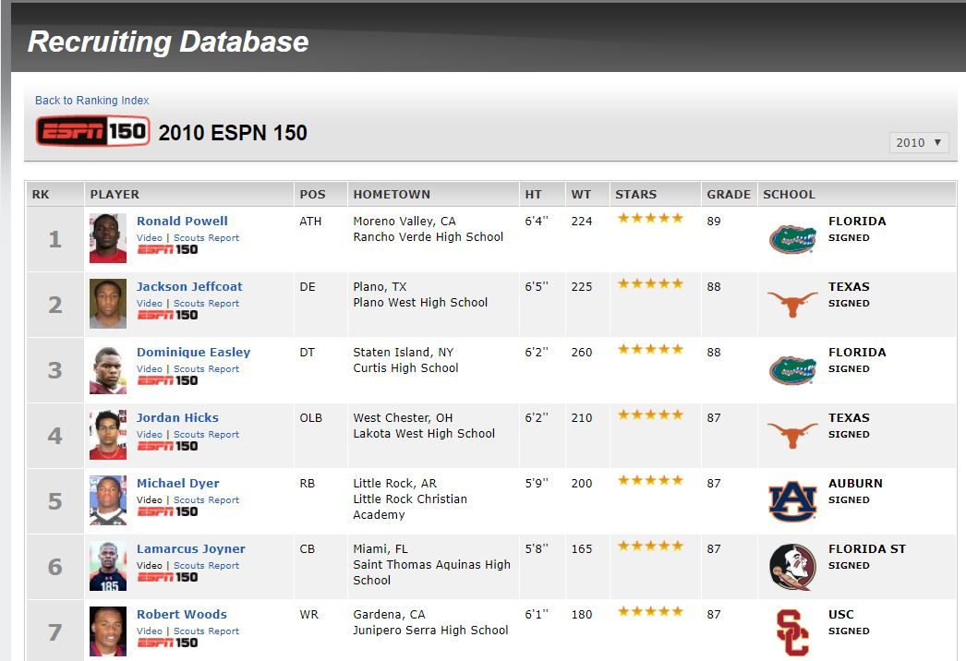
Source of Data
Notes:
Talk about Rivals

Slide 7
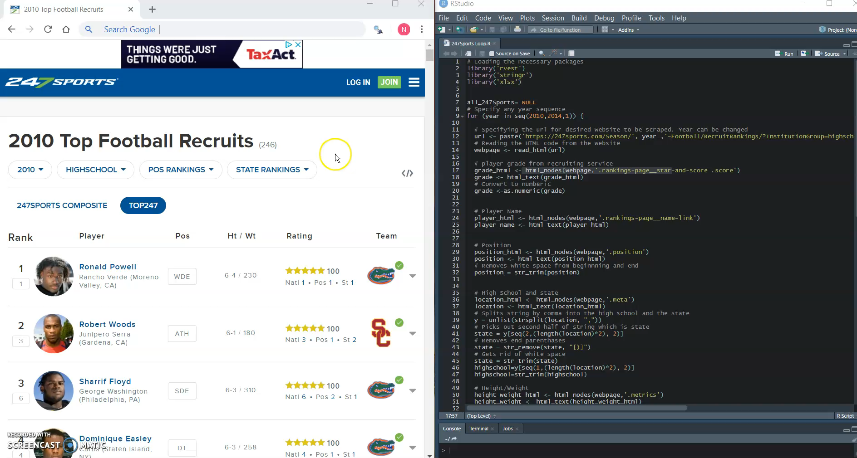
SelectorGadget

Slide 8

247Sports
Ranks top 247 players in each recruiting class
2010-2014 for a total of 1,235 players
975 public school players. 447 of these in south region.
Notes:
Purchased by CBS in 2015

Slide 9

ESPN
Ranks top 150 players in each recruiting class
2009-2014 for a total of 900 players
748 public school players. 407 of these in south region.
Notes:
2013 became 300

Slide 10
Issues
Formatting height and weight (6-4 / 230 → two variables: Height 76, Weight 230)
Formatting HS and State (Skyline (Dallas, TX) → two variables: HS Skyline, State TX)
Duplicates
Names matching when categorizing as drafted or undrafted (nicknames, jr., III, De’Anthony Thomas vs. DeAnthony Thomas)

Slide 11
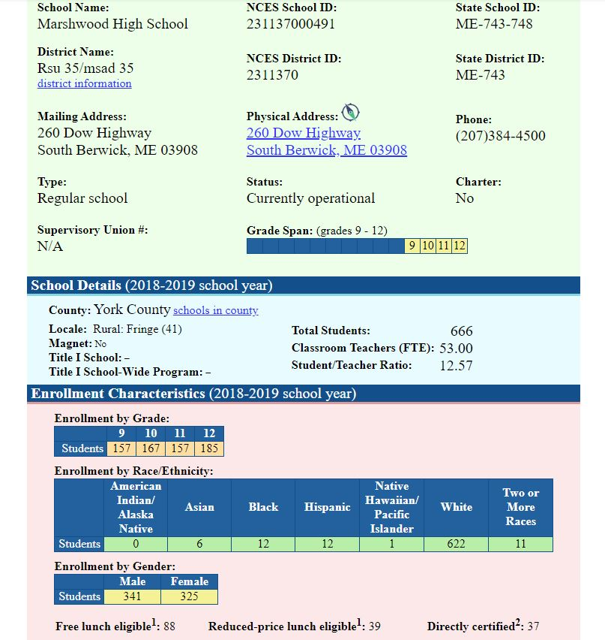
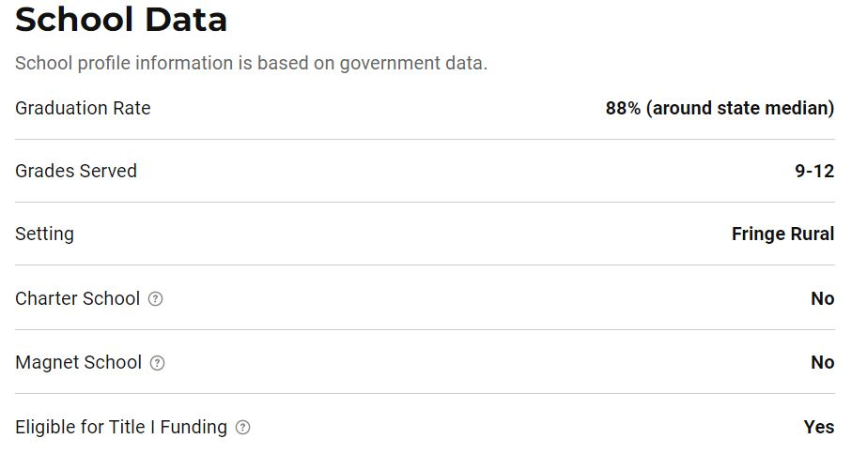
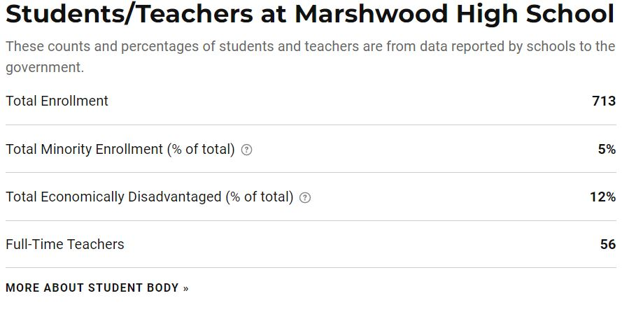
High School Data

Slide 12
Independent Variables
Variable | Description
Grade | Discrete quantitative. Based on assessment by scouts at each website.
Height | Continuous quantitative. Height of the recruit.
Weight | Discrete quantitative. Weight of the recruit.
Enrollment | Discrete quantitative. High school enrollment based on USNews Education.
Minority | Continuous quantitative. Percentage of minority students in high school of recruit.
EconomicDis | Continuous quantitative. Percentage of students in high school of recruit receiving free or reduced lunch.
Graduation | Continuous quantitative. Graduation rate of students in recruit’s high school.
Northeast | Binary, 1=Yes, 0=No. States include ME, NH, MA, RI, CT, VT, NY, PA, NJ, DC, DE, and MD
South | Binary, 1=Yes, 0=No. States include WV, VA, KY, TN, NC, SC, GA, AL, MS, AR, FL, and LA
Southwest | Binary, 1=Yes, 0=No. States include TX, OK, NM, and AZ
Midwest | Binary, 1=Yes, 0=No. States include OH, IN, MI, IL, MO, WI, MN, IA, KS, NE, SD, and ND
West | Binary, 1=Yes, 0=No. States include CO, WY, MT, ID, WA, OR, CA, AK, HI, UT, and NV
OFF | Binary, 1=Yes, 0=No. Positions include DUAL, PRO, OC, OG, OT, RB, APB, WR, TE, for 247 and QB, QB-DT, QB-PP, OC, OG, OT, RB, WR, TE, TE-H, and TE-Y for ESPN
DEF | Binary, 1=Yes, 0=No. Positions include SDE, WDE, DT, ILB, OLB, S, and CB for 247 and DE, DT, ILB, OLB, S, and CB for ESPN
Drafted | Binary, 1=Drafted, 0=Undrafted
Variable | Description
Grade | Discrete quantitative. Based on assessment by scouts at each website.
Height | Continuous quantitative. Height of the recruit.
Weight | Discrete quantitative. Weight of the recruit.
Enrollment | Discrete quantitative. High school enrollment based on USNews Education.
Minority | Continuous quantitative. Percentage of minority students in high school of recruit.
EconomicDis | Continuous quantitative. Percentage of students in high school of recruit receiving free or reduced lunch.
Graduation | Continuous quantitative. Graduation rate of students in recruit’s high school.
QB | Binary, 1=Yes, 0=No. Positions include DUAL and PRO for 247 and QB, QB-DT, and QB-PP for ESPN
OL | Binary, 1=Yes, 0=No. Positions include OC, OG, and OT
RB | Binary, 1=Yes, 0=No. Positions include RB and APB
REC | Binary, 1=Yes, 0=No. Positions include WR and TE for 247 and WR, TE, TE-H, and TE-Y for ESPN
DL | Binary, 1=Yes, 0=No. Positions include SDE, WDE, and DT for 247 and DE and DT for ESPN
LB | Binary, 1=Yes, 0=No. Positions include ILB and OLB
DB | Binary, 1=Yes, 0=No. Positions include S CB
Drafted | Binary, 1=Drafted, 0=Undrafted
Notes:
247 Grades: 90-105
ESPN Grades: 80-95

Slide 13
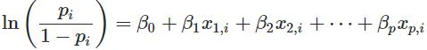
Logistic Regression
“bestglm” package finds best models based on AIC or BIC for up to 15 independent variables
Began with top 5 AIC models
Optimal cutoff function (0.52-0.54)
p-values for significance of independent variables
Simplest models possible

Slide 14
AIC vs. BIC
Both penalized likelihood criteria. Want both to be as small as possible.
Akaike’s Information Criteria (AIC): Selects more complex models and emphasizes model performance. Frequentist approach.
Bayesian Information Criteria (BIC): Performs worse with smaller training datasets. Penalizes more for additional parameters. Bayesian approach.
Notes:
BIC: “if a selection of candidate models includes a true model for the dataset, then the probability that BIC will select the true model increases with the size of the training dataset”

Slide 15
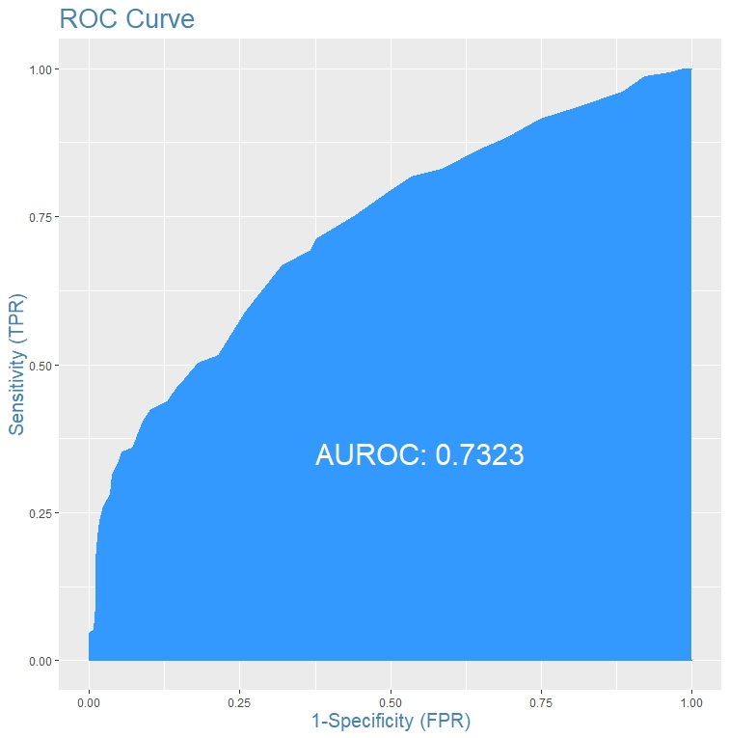
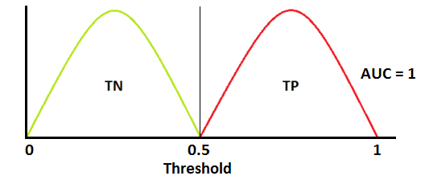
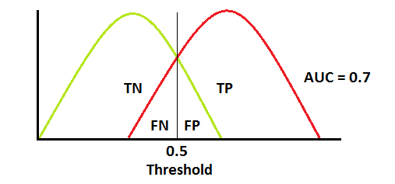
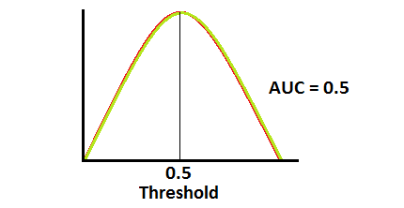
AUROC Curve
Area Under Receiving Operating Characteristic (AUROC) Curve
Measure of predictive power and Type I (FP) and Type II Error (FN) of the model
AUC of 0.5 has no predictive power. 1 perfectly classifies.
Example of ROC curve for 247 South dataset provided
South Region

Slide 16
Model Diagnostic
Misclassification Error: number of incorrect predictions divided by total number of observations. This should be minimized to 0.
Sensitivity: number of drafted players predicted to be drafted divided by total number of drafted players. This should be maximized to 1.
Specificity: number of undrafted players predicted to be undrafted divided by total number of undrafted players. This should be maximized to 1.
Precision: number of drafted players predicted to be drafted divided by total number of drafted players. This should be maximized to 1.

Slide 17
Decision Tree
Partitions the binary response variable into subsets based on similarities in the independent variables
Uses K-fold cross-validation to find the deviance or number of misclassifications to prune and cut off the least important splits
Cross validation is a resampling method for limited data that splits the data into smaller training sets
Use many of the same diagnostics from logistic regression

Slide 18
Public Region
 | 247 Logistic | 247 Tree | ESPN Logistic | ESPN Tree
Misclass. Error | 0.2431 | 0.2431 | 0.2634 | 0.2660
Sensitivity | 0.2837 | 0.2457 | 0.1909 | 0.1227
Specificity | 0.9563 | 0.9723 | 0.9640 | 0.9886
Precision | 0.7321 | 0.7889 | 0.6885 | 0.8181
AUROC | 0.6993 | N/A | 0.6819 | N/A

Slide 19
Choosing a Model
ESPN Logistic worst in every measure
ESPN Tree is very conservative in predicting drafted players
247 Logistic and Tree are fairly similar
247 Logistic most correctly identified draftees
vs.

Slide 20
South Region
 | 247 Logistic | 247 Tree | ESPN Logistic | ESPN Tree
Misclass. Error | 0.2573 | 0.2573 | 0.2889 | 0.2727
Sensitivity | 0.3594 | 0.3072 | 0.2481 | 0.3609
Specificity | 0.9422 | 0.9694 | 0.9343 | 0.9051
Precision | 0.7639 | 0.8393 | 0.6471 | 0.6486
AUROC | 0.7323 | NA | 0.708 | NA

Slide 21
Choosing a Model
Both ESPN models are worse in every measure
247 tree is slightly more conservative than the logistic model
Either of the 247 models could be used, but want to compare logistic

Slide 22
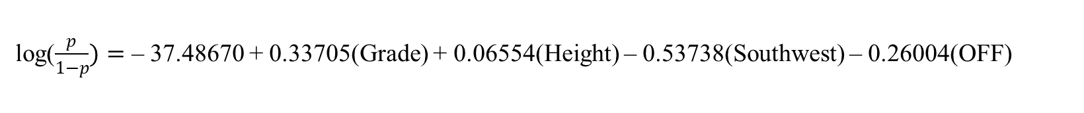
Public 247 Logistic
log($\frac{p}{1−p})=$ – 37.48670 + 0.33705(Grade) + 0.06554(Height) – 0.53738(Southwest) – 0.26004(OFF)

Slide 23
Public 247 Logistic (cont.)
Holding all other variables constant…
Taller players or players with higher recruiting grades are more likely to be drafted
Players from the southwest or play on offense are less likely to be drafted
All predictors are significant at 0.1 level of significance
Top 22 players in terms of probability of being drafted were drafted
If the cutoff for being drafted is more than 0.66, then 37/41 (90.2%) players were drafted

Slide 24
South 247 Logistic
log($\frac{p}{1−p})=$ – 47.928085 + 0.389430(Grade) + 0.161339(Height) – 0.007026(Weight) – 0.727773(REC)

Slide 25
South 247 Logistic (cont.)
Holding all other variables constant…
Taller players or players with higher recruiting grades are more likely to be drafted
Heavier players or players that play receiver are less likely to be drafted
All predictors are significant at 0.05 level of significance
If the cutoff for being drafted is greater than 0.66, then 36/41 (87.8%) players were drafted

Slide 26
Top Prospects
Public
South
Rank | Name | Prob | Drafted
1 | Jadeveon Clowney | 0.950253 | Yes
2 | Robert Nkemdiche | 0.822887 | Yes
3 | Arik Armstead | 0.811705 | Yes
4 | Chris Jones | 0.779803 | Yes
5 | Ronald Powell | 0.768344 | Yes
6 | Da'Shawn Hand | 0.768344 | Yes
7 | Cam Robinson | 0.756862 | Yes
8 | Sharrif Floyd | 0.756475 | Yes
9 | Dominique Easley | 0.756475 | Yes
10 | Timmy Jernigan | 0.756475 | Yes
11 | Dorial Green | 0.7446 | Yes
 | Beckham
12 | Laremy Tunsil | 0.7446 | Yes
13 | Eddie Vanderdoes | 0.7442 | Yes
14 | Dorian Johnson | 0.731939 | Yes
15 | Myles Garrett | 0.730794 | Yes
16 | Aaron Lynch | 0.729681 | Yes
17 | Landon Collins | 0.718461 | Yes
18 | Eddie Goldman | 0.716562 | Yes
19 | Vernon Hargreaves | 0.705017 | Yes
20 | Montravius Adams | 0.703065 | Yes
Rank | Name | Prob | Drafted
1 | Jadeveon Clowney | 0.973236 | Yes
2 | Chris Jones | 0.84311 | Yes
3 | Robert Nkemdiche | 0.84074 | Yes
4 | Laremy Tunsil | 0.821528 | Yes
5 | Aaron Lynch | 0.821085 | Yes
6 | Da'Shawn Hand | 0.804526 | Yes
7 | Cam Robinson | 0.8033 | Yes
8 | Matthew Thomas | 0.791029 | No
9 | Christian Miller | 0.790427 | Yes
10 | Eddie Williams | 0.780428 | No
11 | Jeff Driskel | 0.774896 | Yes
12 | Stephone Anthony | 0.764986 | Yes
13 | Rashaan Evans | 0.764986 | Yes
14 | Marlon Humphrey | 0.763812 | Yes
15 | Vernon Hargreaves | 0.763179 | Yes
16 | Quin Blanding | 0.761222 | No
17 | Landon Collins | 0.760584 | Yes
18 | Timmy Jernigan | 0.759164 | Yes
19 | T.J. Yeldon | 0.754778 | Yes
20 | D.J. Humphries | 0.753335 | Yes
Notes:
Matt Thomas: Freshman shoulder surgery, failed drug test=missed 6 games, suspended whole season for academic ineligibility.
Eddie Williams: Mugged someone, plead guilty, never played a snap for Alabama

Slide 27
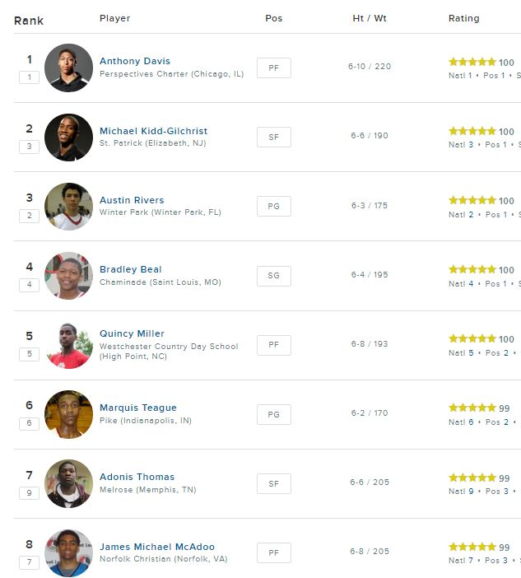
Conclusion
247Sports is a better source of data than ESPN
Grade and Height are the two variables that have the most positive impact on being drafted
Socioeconomic data does not seem to have much effect
Expand beyond top 247 players
Could be replicated with basketball data

